Slide 1
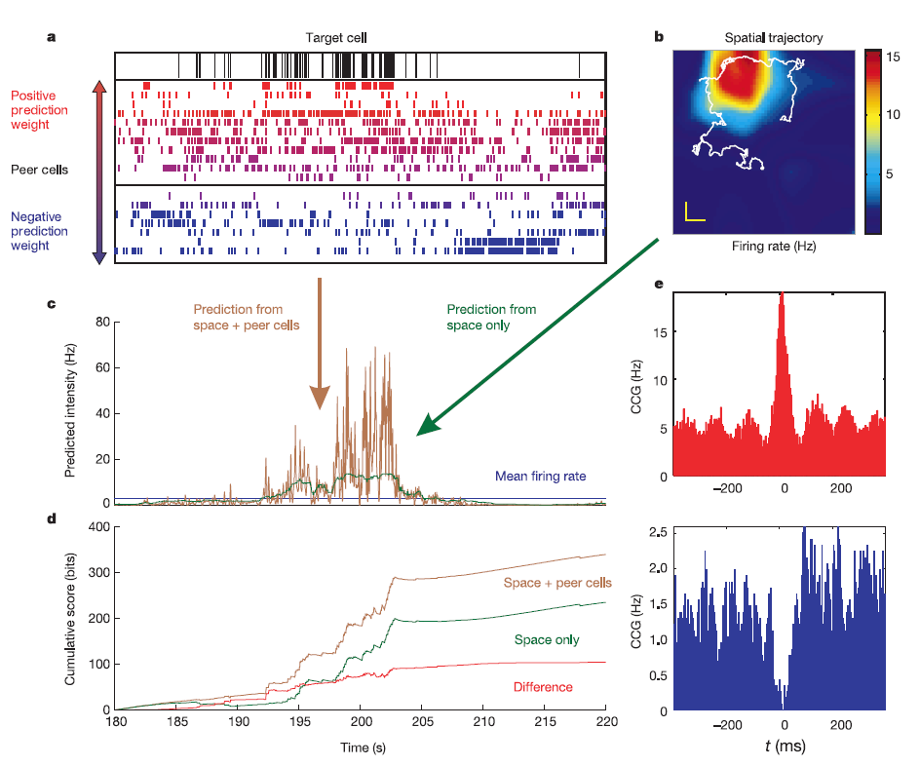
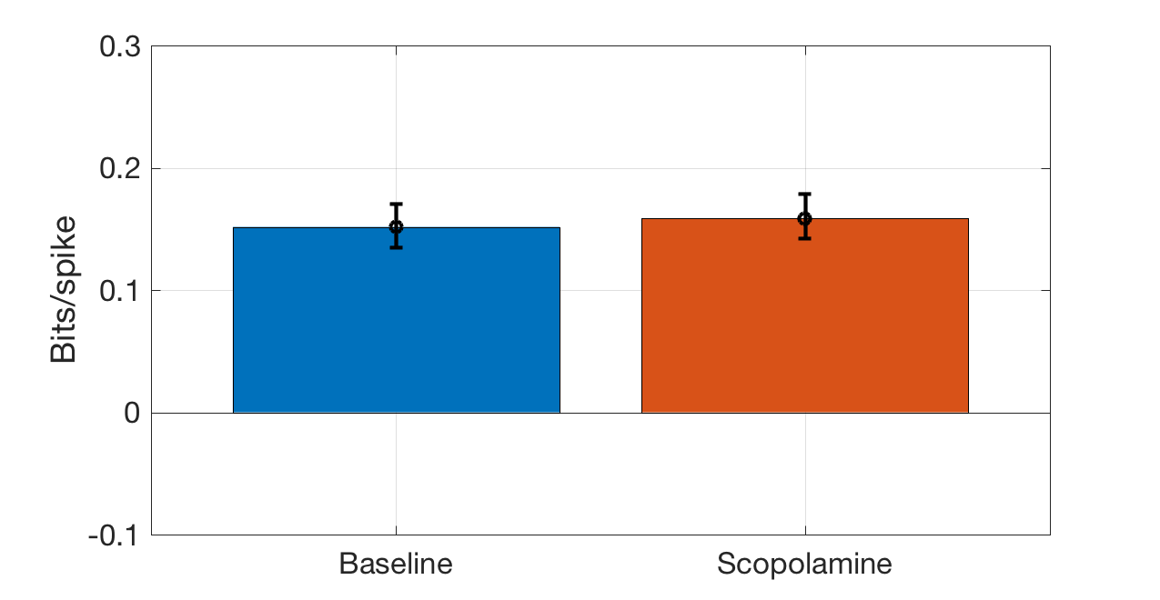
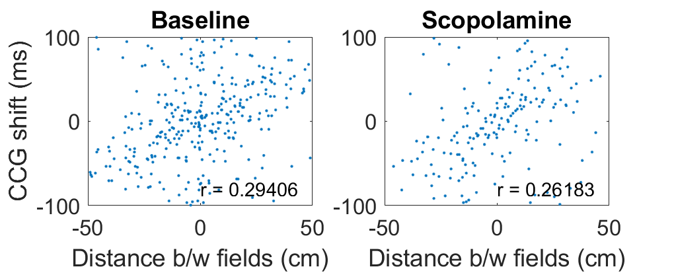
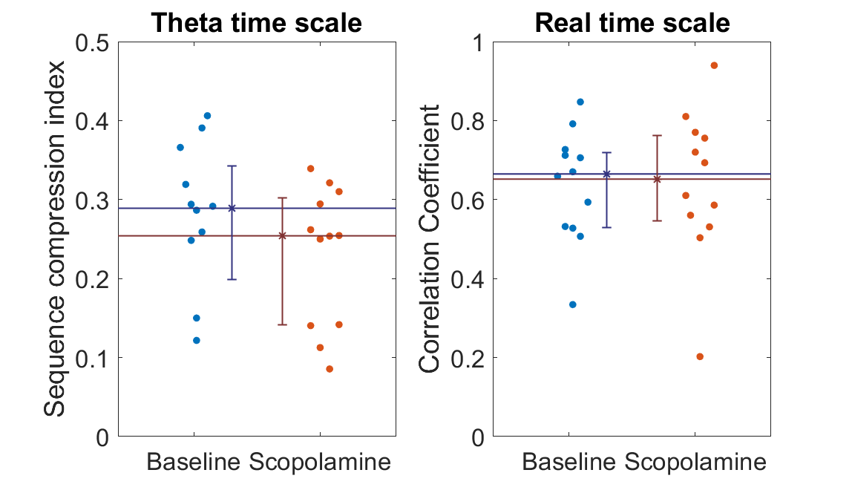
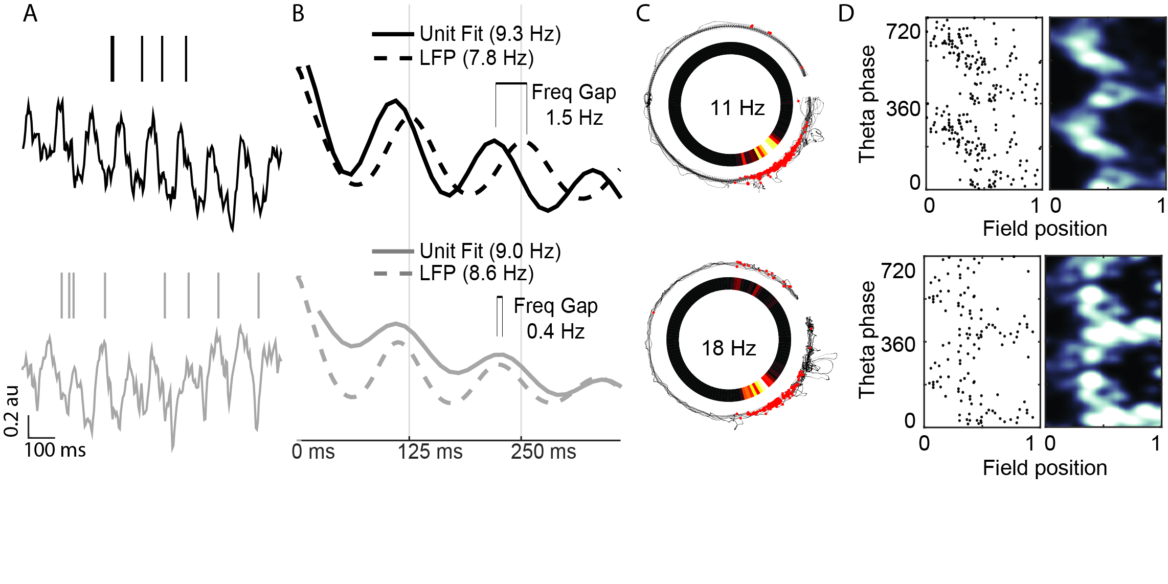
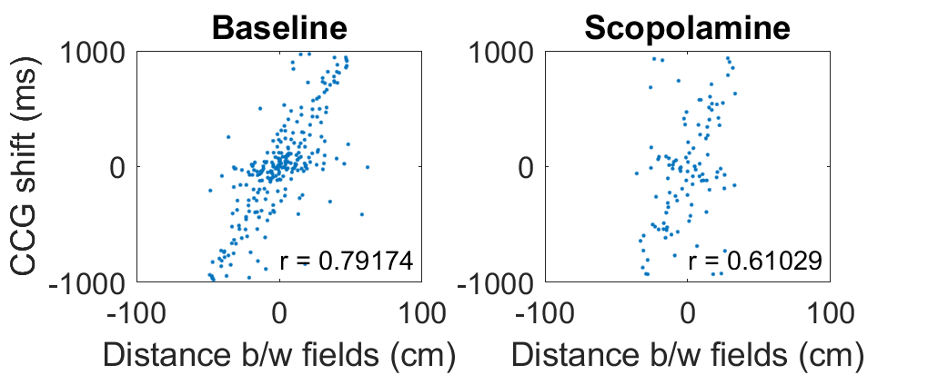
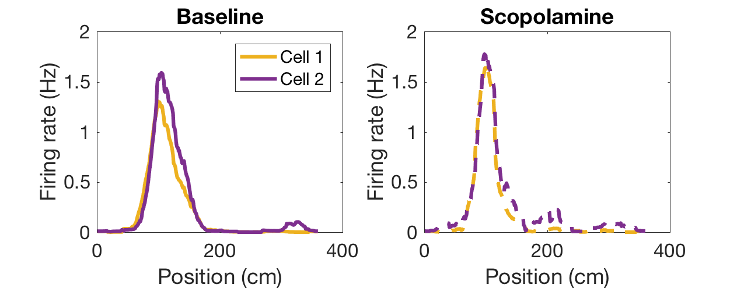
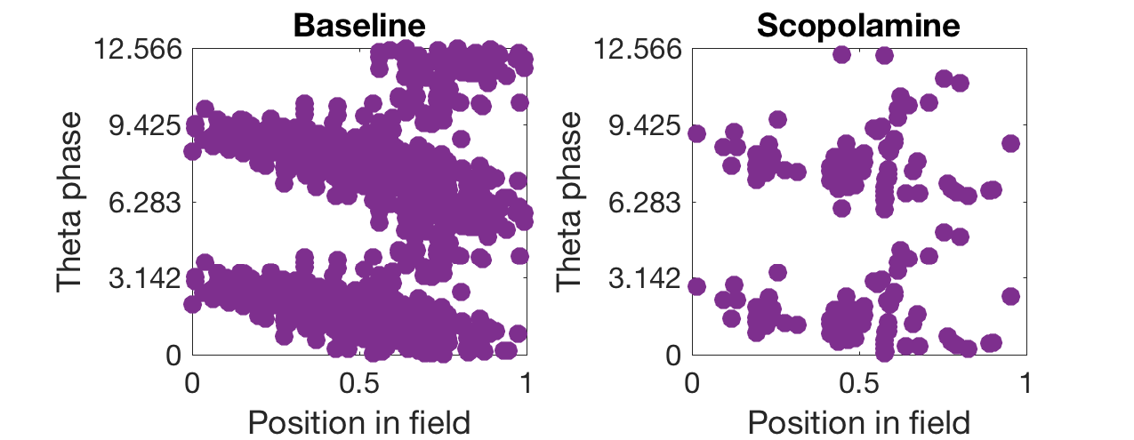
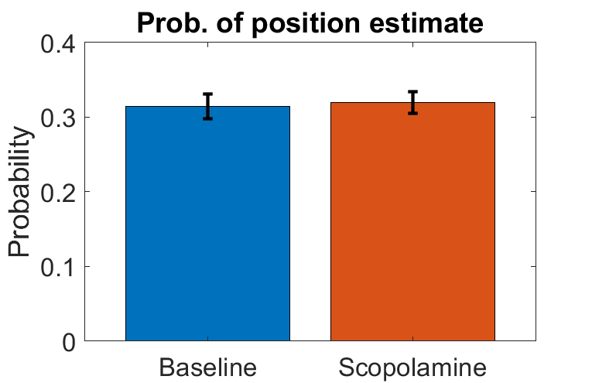
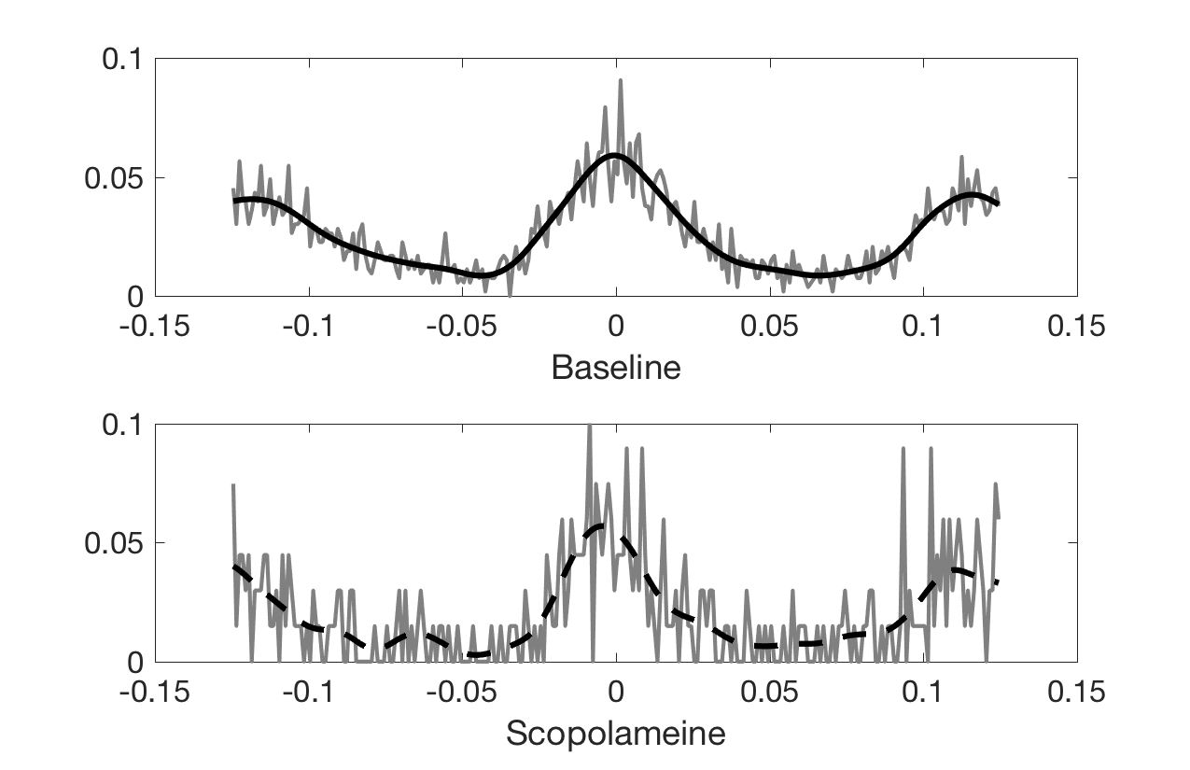
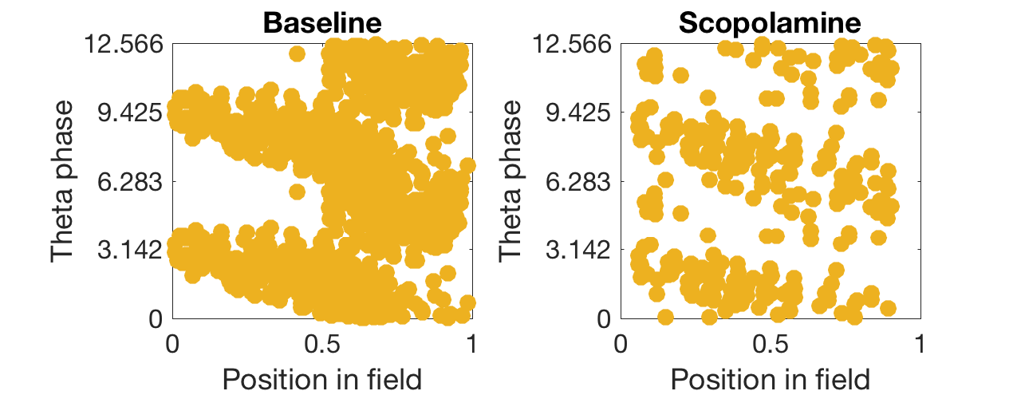
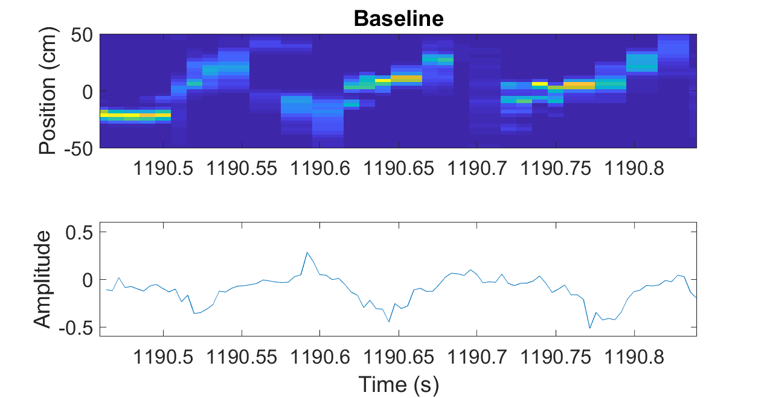
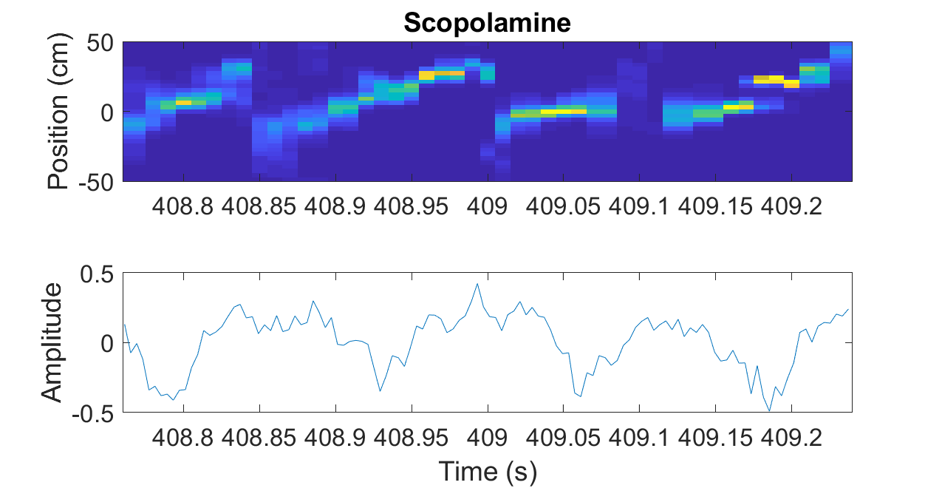
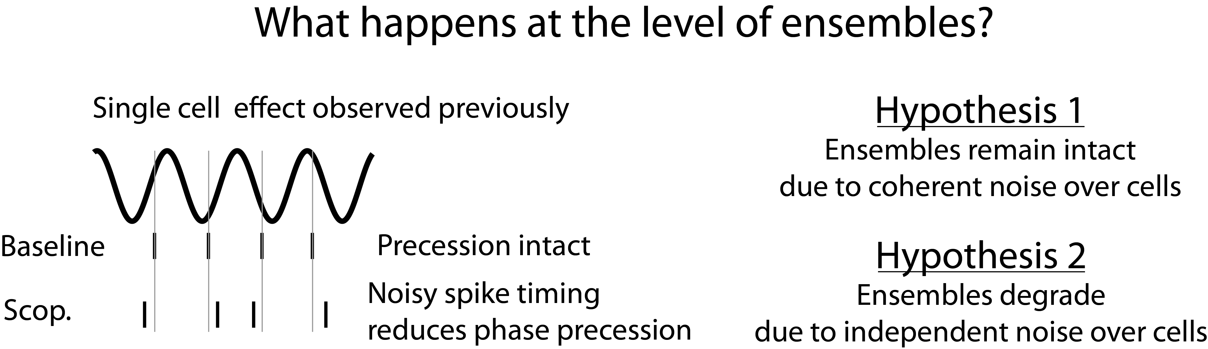
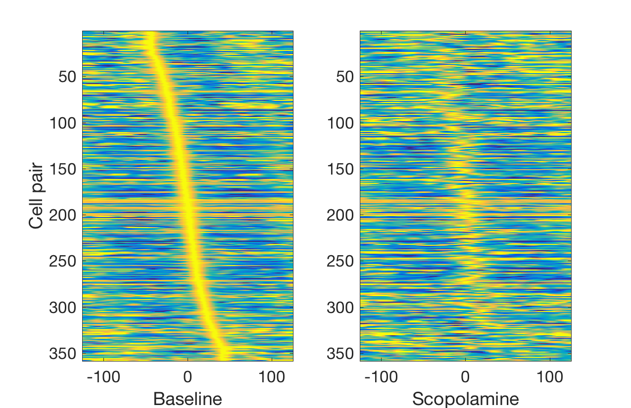
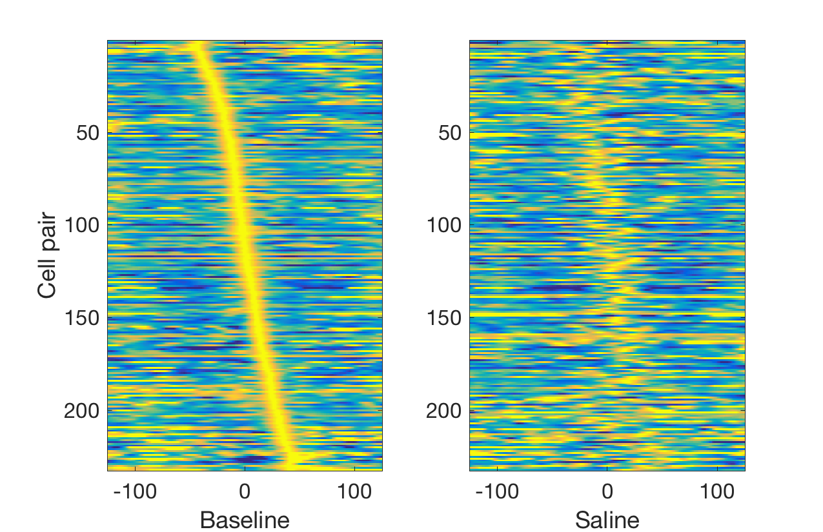
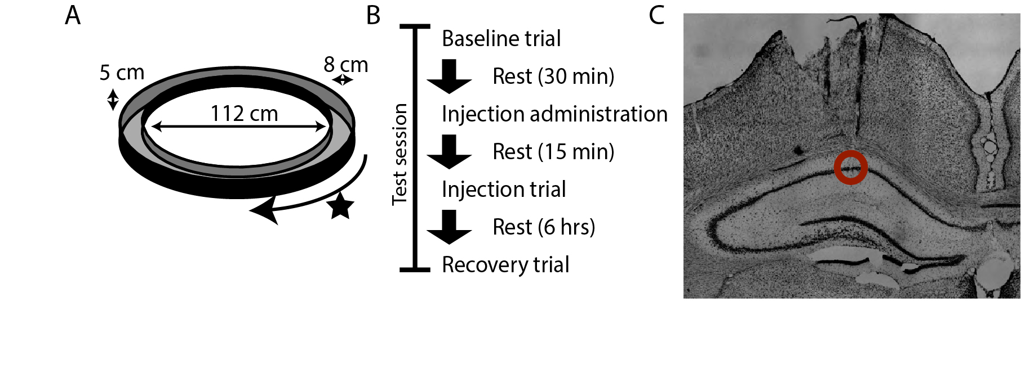
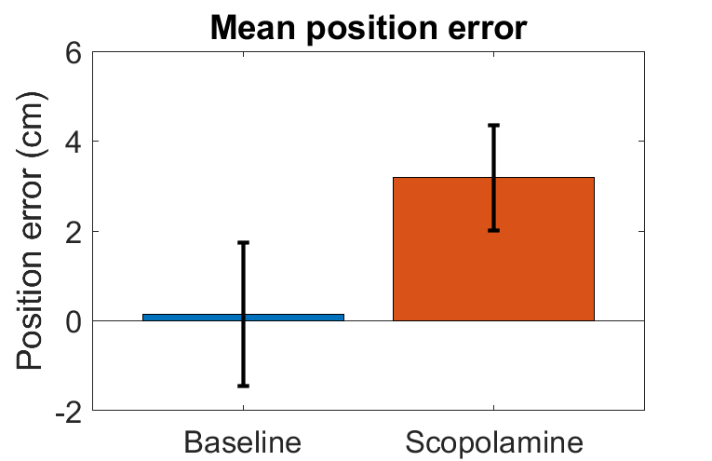
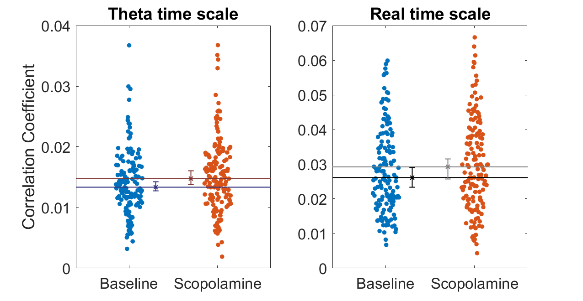
Effects of cholinergic disruption to sequence dynamics of hippocampal place cells
Sarah Jo Venditto & Ehren Newman
Department of Psychological and Brain Sciences, Indiana University, Bloomington, IN
MOTIVATION
RESULTS
RESULTS CONTINUED
Acetylcholine plays an important role in cognitive function: memory and attention both depend on intact cholinergic tone. However, the circuit level mechanisms of acetylcholine are not well understood.
1. Analysis of assembly integrity
3. Analysis of temporal coding of space over cell pairs
Previously we found that cholinergic disruption disrupts phase coding of CA1 place cells:
Population activity improves predictability of cell spiking similarly during scopolamine and baseline, indicating intact assemblies.
Sequence compression index not significantly changed, indicating intact temporal coding of space over cell pairs
Harris et al 2003
4. Analysis of population coding of space at fine time scale
2. Analysis of pair-wise temporal correlations over place cells
These results show disruption on a single cell level – how is this effect reflected on populations of neurons?
Decoding position from 40ms epochs gives same peak probability of position under scopolamine, indicating that population code at fine temporal scale (40ms) remains intact.
Two possibilities:
Disruption is coherent: cells remain coupled despite decoupling from theta
Disruption is incoherent: cells are decoupled from each other
Representative cell pair shows diminished phase precession and preserved CCG
Theta sequences are present in both baseline and scopolamine trials, indicating preserved population dynamics.
CONCLUSIONS
METHODS
Assemblies remain intact after systemic blockade of muscarinic cholinergic receptors.
Reduced phase precession is not due to noisy spike timing at the individual cell level.
What is causing the loss of phase precession?
CCG alignment preserved as well after scopolamine injection as in saline control
Shift in sequence content?
Disconnect between ensembles and LFP?
REFERENCES
Scopolamine injection
Dosage: 0.5 mg/Kg
Control: Equal volume saline
Recording procedutes
dHPC coord: 5.5AP,2.5ML
16 tetrodes, bundle of 1.8 mm width
Overall correlation between cell pairs is modestly, but significantly, increased
Newman EL, Venditto SJC, Climer JR, Petter EA, Gillet SN, Levy S (2017). Precise spike timing dynamics of hippocampal place cell activity sensitive to cholinergic disruption. Hippocampus.
Harris KD, Csicsvari J, Hirase H, Dragoi G, Buzsaki G (2003) Organization of cell assemblies in the hippocampus. Nature.
Dragoi G, Buzsaki G (2006). Temporal Encoding of Place Sequences by Hippocampal Cell Assemblies. Neuron.
Zhang K, Ginzburg I, McNaughton BL, Sejnowski TJ (1998). Journal of Neurophysiology.

